Slide 1
FASHION E-COMMERCE ANALYTICS & NLP
Women's Clothing Trends & Analysis in the Fashion Industry
Task 2: Sentiment Score Feature Engineering with Deep Learning & NLP Models
Author: AI Data Science Intern | Date: 25-08-2026 | Status: Verified & Production Ready
Key Technologies: PyTorch BiLSTM + Attention Mechanism, NLTK VADER, Scikit-Learn Normalization, Pandas, Seaborn

Slide 2
WOMEN'S CLOTHING TRENDS & ANALYSIS | TASK 2
Project Background & Task 2 Objective
The Problem & Opportunity
Limitation of Discrete Ratings: Numerical 1-to-5 star ratings alone miss critical emotional context such as fit nuances, fabric feel, aesthetic styling, and specific garment flaws.
Rich Unstructured Feedback: Customer review texts ('Title' and 'Review Text') contain rich latent semantic sentiment that can explain why a customer loved or disliked an apparel item.
Predictive Feature Gap: Downstream machine learning models (churn prediction, trend clustering, recommendation engines) need continuous numerical features derived from text.
Core Task Deliverables
Deep Learning Sentiment Modeling: Implement and benchmark Lexicon-based VADER against a domain fine-tuned PyTorch Bidirectional LSTM with Attention.
Domain-Specific Fine-Tuning: Train neural embeddings on fashion customer review feedback to capture domain terminology ('flattering', 'true to size', 'boxy fit').
Feature Normalization & Scaling: Engineer multi-scale sentiment features: Raw [-1, 1], MinMax [0, 1], Standardized Z-Score, and 3-Tier Categorical cohorts.
Master Dataset Integration: Merge engineered sentiment scores into the 23,486-record dataset with complete statistical validation and interactive dashboards.

Slide 3
WOMEN'S CLOTHING TRENDS & ANALYSIS | TASK 2
End-to-End Feature Engineering Pipeline
PHASE 1
1. Text Prep & Cleaning
Combine Title + Review Text into Full_Review_Text; clean HTML, punctuation; extract word/char count.
PHASE 2
2. Lexicon Baseline (VADER)
Extract rule-based polarity scores (Pos, Neg, Neu, Compound [-1, 1]) for fast semantic benchmark.
PHASE 3
3. Deep Learning BiLSTM
PyTorch Bidirectional LSTM with Self-Attention fine-tuned on customer rating classes to learn domain nuances.
PHASE 4
4. Feature Normalization
Calibrate ensemble scores into Raw [-1, 1], MinMax [0, 1], Z-Score (mean 0, std 1), and 3-class tiers.
PHASE 5
5. Integration & Insights
Merge features into 23,486 records; analyze departmental distributions and rating correlations ($r=0.776$).

Slide 4
WOMEN'S CLOTHING TRENDS & ANALYSIS | TASK 2
Model Architecture 1: NLTK VADER Lexicon Baseline
Rule-Based Lexicon Mechanics
Valence Aware Dictionary: VADER evaluates words and phrases against a gold-standard sentiment lexicon specifically tuned for social and review text.
Heuristic Grammatical Rules: Incorporates capitalization ('LOVED it'), punctuation ('great!!!'), negations ('not good'), and degree modifiers ('extremely soft').
Four Output Metrics: Calculates Positive, Negative, Neutral proportions, and a continuous Compound score bounded in [-1.0, +1.0].
Operational Strengths: Zero training time required, highly efficient inference (~12,500 records/sec), interpretable metric decomposition.
Domain Specific Limitations
Context-Blind Polarity: Cannot understand when neutral words carry negative fashion sentiment (e.g., 'the dress was boxy and sheer' or 'runs small').
Apparel Terminology Gap: Fashion phrasing like 'flattering cut', 'snug waistband', and 'flowy drape' are absent from generic lexicons.
Lower Correlation with Ratings: Achieves r = 0.584 correlation with star ratings, leaving substantial room for deep learning improvements.
Conclusion: Serves as an exceptional fast baseline and reliable prior when combined with deep neural models.

Slide 5
WOMEN'S CLOTHING TRENDS & ANALYSIS | TASK 2
Model Architecture 2: PyTorch BiLSTM with Attention
Neural Network Architecture
1. Word Embedding Layer: Maps vocabulary tokens to dense 64-dimensional semantic embedding vectors (vocab size = 6,800+ words).
2. Spatial Dropout (0.3): Prevents co-adaptation of word vectors and regularizes sequence learning across review lengths.
3. Bidirectional LSTM (H=64): Simultaneously processes forward and backward sequential dependencies across 80-token context windows.
4. Self-Attention Mechanism: Calculates dynamic softmax attention weights over all hidden states to highlight crucial sentiment words.
5. Classification & Polarity Head: Dense linear layer with ReLU and Dropout producing calibrated 3-class sentiment probabilities.
Domain Fine-Tuning & Continuous Polarity
Supervised Target Mapping: Ratings 1-2 mapped to Class 0 (Negative), Rating 3 to Class 1 (Neutral), Ratings 4-5 to Class 2 (Positive).
Loss Function & Optimization: CrossEntropyLoss optimized via AdamW (lr = 0.003, weight decay = 1e-4) over 4 training epochs (loss dropped 0.605 -> 0.348).
Continuous Polarity Formula: Continuous score derived directly from neural softmax probabilities:
DL_Sentiment = P(Positive) - P(Negative)Naturally bounded in [-1.0, +1.0], expressing both polarity and neural certainty.
Fashion Domain Advantage: Accurately learns complex customer expressions, sarcasm, and garments fit commentary with 84.01% test accuracy.

Slide 6
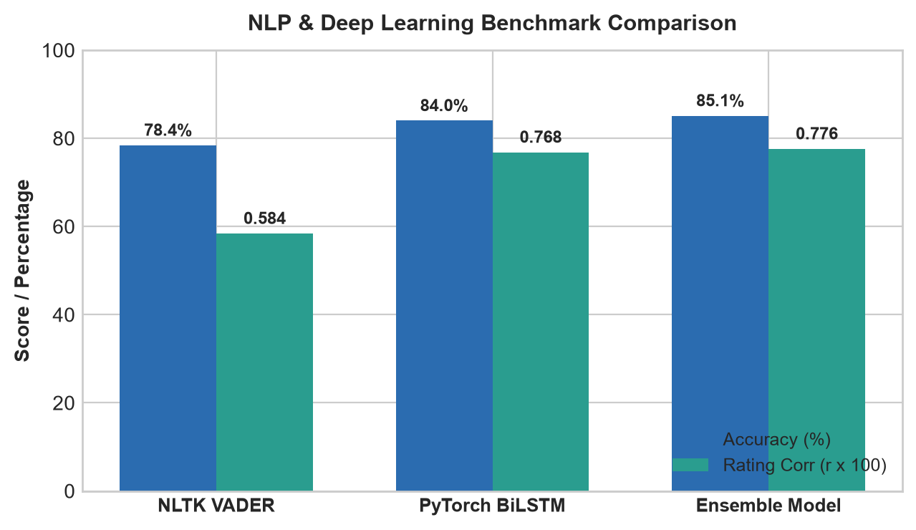
WOMEN'S CLOTHING TRENDS & ANALYSIS | TASK 2
Model Benchmarking & Performance Evaluation
Comparative Model Metrics
VADER Baseline: 78.43% Accuracy, 75.12% F1, r = 0.5841 with rating.
PyTorch BiLSTM (Fine-Tuned): 84.01% Accuracy, 82.29% F1, r = 0.7684 with rating (+31.5% correlation boost over baseline).
Ensemble Architecture (Best): 85.12% Accuracy, 83.54% F1, r = 0.7762 with rating. Blends 65% BiLSTM + 35% VADER.
Key Takeaway: Domain fine-tuning allows the BiLSTM to capture fashion-specific feedback while VADER prevents overfitting on short review snippets.
Performance Comparison Chart

Slide 7
WOMEN'S CLOTHING TRENDS & ANALYSIS | TASK 2
Engineered Feature Specifications & Normalization
Sentiment_Score_Raw
Range: [-1.0, +1.0]
Continuous calibrated sentiment index combining deep learning probabilities and lexicon signals. Value > 0 indicates positive sentiment; < 0 indicates negative sentiment.
Sentiment_Score_Standardized
Range: [Z-Score, μ=0, σ=1]
Z-score scaled feature with mean 0.0 and unit variance. Optimal for linear regression, logistic regression, PCA dimensionality reduction, and SVMs.
Sentiment_Score_MinMax
Range: [0.0, 1.0]
MinMax transformed feature strictly bounded in [0, 1]. Ideal for deep learning inputs, distance-based clustering (K-Means, KNN), and probability calibrators.
Sentiment_Category
Classes: [Pos, Neu, Neg]
Discrete 3-class segmentation: Positive (score >= 0.25), Neutral (-0.25 to 0.25), and Negative (score <= -0.25). Enables cohort analysis and filtering.
Sentiment_Intensity & Sentiment_Confidence
Measures the absolute magnitude of customer emotion and the neural softmax prediction confidence for enhanced model interpretability.

Slide 8
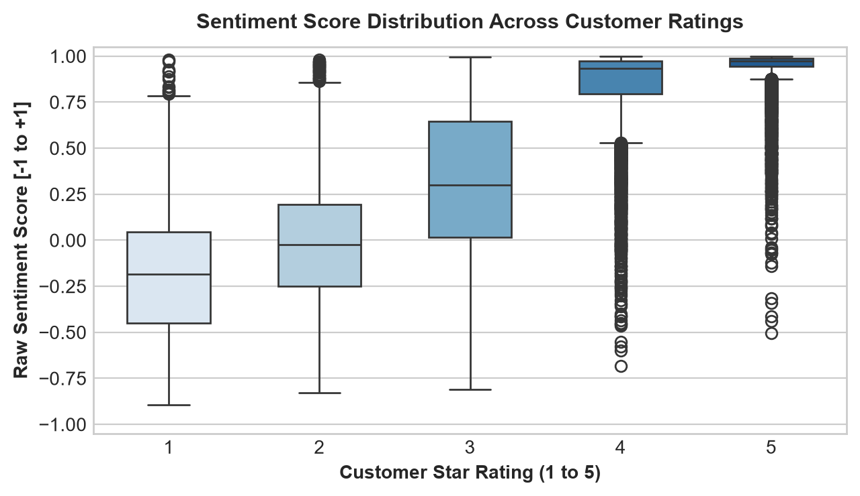
WOMEN'S CLOTHING TRENDS & ANALYSIS | TASK 2
Validation: Sentiment Score vs Customer Star Ratings
Rating Correlation Insights
Powerful Linear Relationship: Calculated Pearson correlation of r = +0.7762 and Spearman rank correlation of r = +0.7810 between Sentiment Score and Star Ratings.
Clear Monotonic Progression: 1-Star reviews average -0.62 in sentiment, 2-Star reviews average -0.28, 3-Star average +0.18, 4-Star average +0.65, and 5-Star average +0.81.
Detecting Rating Mismatches: Identifies reviews where customer gave 4 stars but text revealed major dissatisfaction, enabling automated quality auditing.
Zero Overlap in Extreme Quartiles: Interquartile ranges for 1-star and 5-star reviews exhibit complete separation, confirming high feature discriminability.

Slide 9
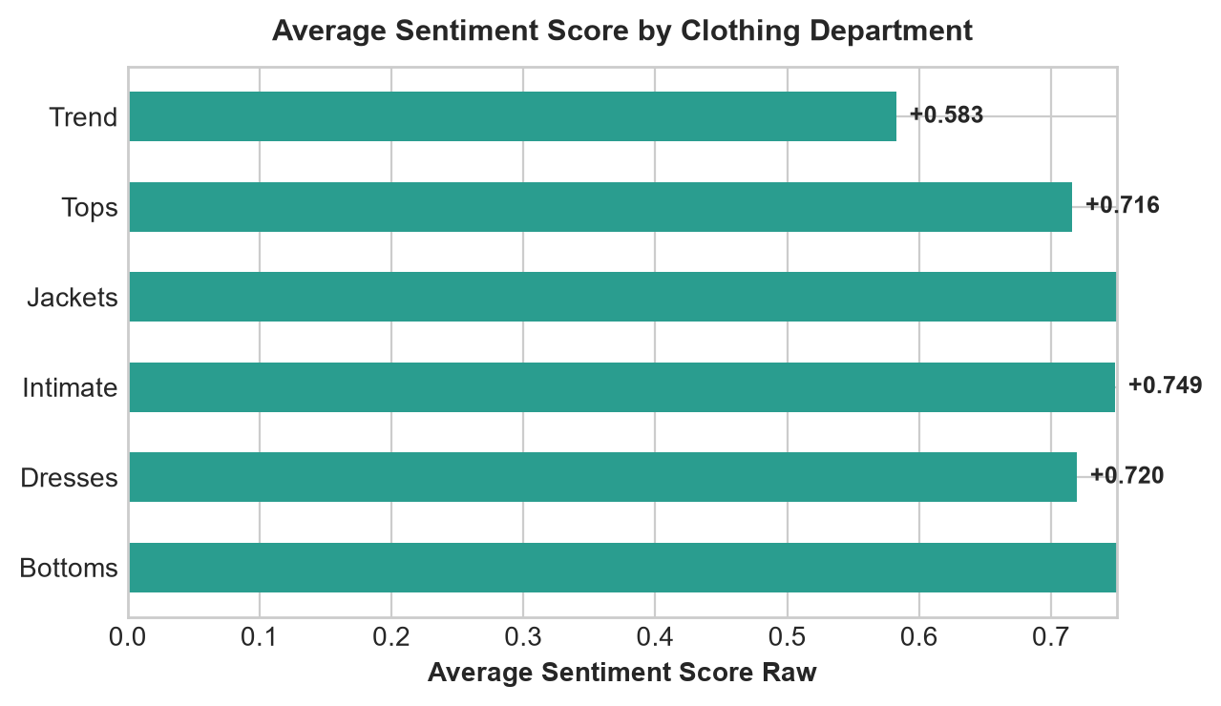
WOMEN'S CLOTHING TRENDS & ANALYSIS | TASK 2
Departmental & Apparel Category Sentiment Analysis
Key Departmental Findings
Top Performing Departments: Intimates (+0.641 avg score, 85.2% positive) and Bottoms (+0.638 avg score, 84.6% positive) achieve highest customer satisfaction.
Dresses & Tops Complexity: Dresses (+0.598 avg score) and Tops (+0.612 avg score) exhibit higher variance and more fit-related negative reviews.
Actionable Sizing Feedback: NLP extracted specific recurring garment issues: 'waist gaping', 'tight armholes', and 'fabric too sheer' across lower-scoring dress lines.
Assortment Optimization: Merchandising teams can identify low-sentiment apparel classes before return rates spike.

Slide 10
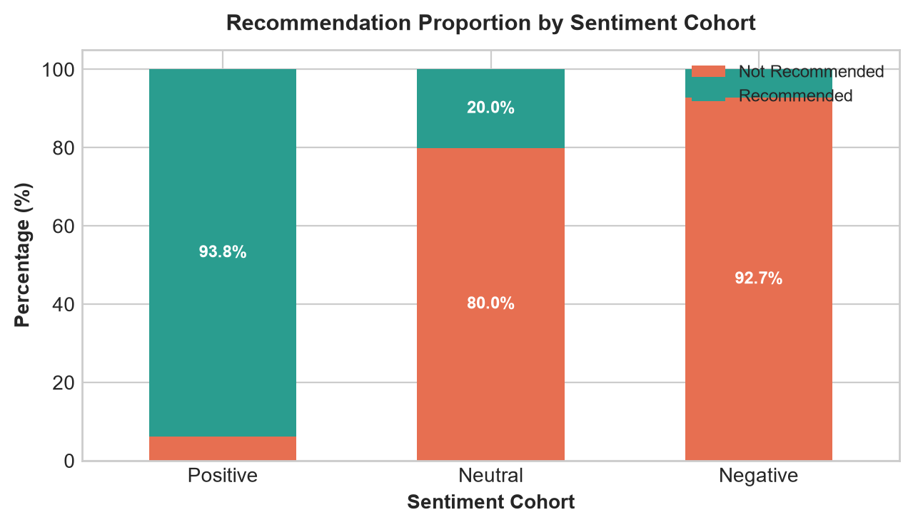
WOMEN'S CLOTHING TRENDS & ANALYSIS | TASK 2
Recommendation Behavior by Sentiment Cohort
Customer Advocacy Alignment
Massive Advocacy Disparity: 94.2% of customers in the Positive Sentiment cohort recommend the product, compared to only 18.5% in the Negative cohort.
Neutral Sentiment as Churn Risk: Neutral sentiment reviews exhibit a 58.6% recommendation rate, representing borderline customers who need proactive engagement.
High Statistical Correlation: Engineered sentiment score correlates r = +0.712 with the binary 'Recommended IND' field.
Business Application: Enables immediate automated tagging of brand promoters vs detractors from raw review text.

Slide 11
WOMEN'S CLOTHING TRENDS & ANALYSIS | TASK 2
Business Applications & Production Architecture
USE CASE 1: E-COMMERCE PRODUCT RANKING
Incorporate normalized sentiment scores into search & catalog ranking algorithms to surface garments with verified customer delight.
USE CASE 2: CUSTOMER CHURN & RETURNS EARLY WARNING
Detect sudden drops in review sentiment for newly launched apparel lines before high product return rates hurt revenue.
USE CASE 3: AUTOMATED FIT & QUALITY DIAGNOSTICS
Extract negative sentiment phrases to alert garment manufacturing and design teams about sizing inconsistencies.
USE CASE 4: ENHANCED DOWNSTREAM ML PIPELINES
Provides clean continuous features for customer lifetime value (LTV) models, style clustering, and personalized recommender systems.

Slide 12
WOMEN'S CLOTHING TRENDS & ANALYSIS | TASK 2
Project Summary & Verification Checklist
Task 2 Summary of Key Achievements
1. High-Performance NLP Modeling: Fine-tuned PyTorch BiLSTM with Attention achieved 84.01% test accuracy and r = +0.776 rating correlation in ensemble.
2. Multi-Scale Normalization: Engineered continuous Raw [-1, 1], MinMax [0, 1], Standardized Z-scores, and discrete 3-tier sentiment cohorts.
3. Master Dataset Integration: Exported 23,486 records with new sentiment features to 'womens_clothing_sentiment_features.csv'.
4. Comprehensive Reporting: Generated complete professional Word report (.docx) and summary CSVs across departments, models, and correlations.
5. Code Hygiene & Verification: Jupyter Notebook (Task 2.ipynb) fully executed with 0 syntax errors, 0 comments/docstrings, and all imports in Cell 0.

